Slide 1

Overview of Monetary Systems

Slide 2
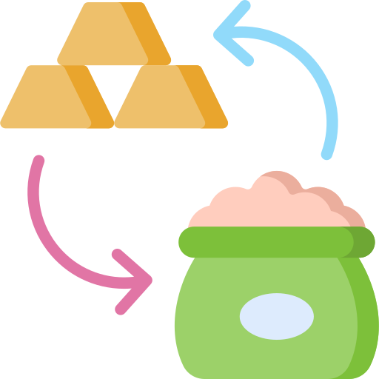
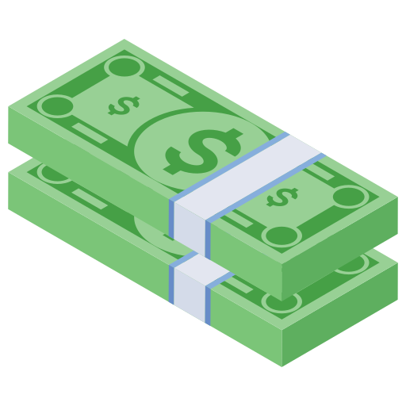
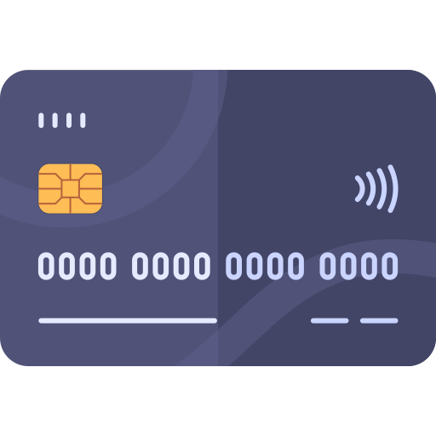


Preliminary Concepts
Barter
Cash
Credit
Online
Market
Cryptocurrency

Slide 3






Barter
Cash
Credit
Online
Market
Cryptocurrency
wants
Is the exchange of goods for goods.
has
Almaz
Bekele

Slide 4

Barter
Cash
Credit
Online
Market
Cryptocurrency
Is the exchange of goods for goods.
Almaz
Bekele

Slide 5

Barter
Cash
Credit
Online
Market
Cryptocurrency
Almaz
Bekele
Samuel

Slide 6
Barter
Cash
Credit
Online
Market
Cryptocurrency
Is the exchange of goods for goods.
Almaz
Bekele
Samuel

Slide 7
Barter
Cash
Credit
Online
Market
Cryptocurrency
Is the exchange of goods for goods.
Pros:
It doesn’t require a third party intermediary (only b/n seller and buyer).
Anonymity.
Cons:
Doesn’t show product’s real worth.
Cumbersome to find someone who
Has exactly the product you want.
And wants exactly the file you have.

Slide 8
Barter
Cash
Credit
Online
Market
Cryptocurrency
Pay with paper money for a product with a specified price tag.
Pros:
It doesn’t require a third party intermediary (only b/n seller and buyer).
Better Anonymity.
Precise definition on how much something is worth.
Allows for offline transaction.
Avoids the possibility of a buyer defaulting on her/his debt.
Cons:
Requires bootstrapping and relies on central system (bank).

Slide 9
Barter
Cash
Credit
Online
Market
Cryptocurrency
Nothing
For now!
wants
Pay with debt for a product.
Traditional Credit
System
has
Almaz
Bekele
Nothing of value currently.

Slide 10
Barter
Cash
Credit
Online
Market
Cryptocurrency
Nothing
For now!
wants
Pay
Back
Pay with debt for a product.
Traditional Credit
System
Almaz
Bekele
Favor owed to him.

Slide 11
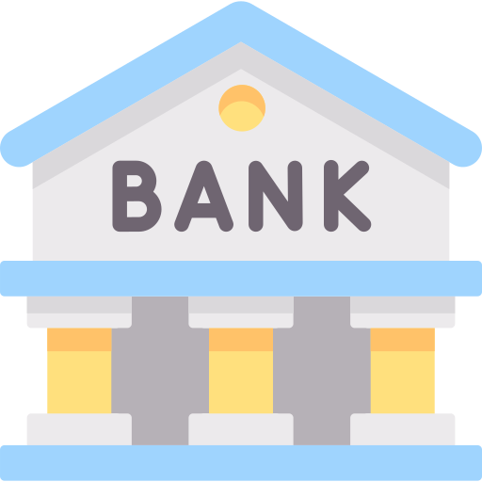
Barter
Cash
Credit
Online
Market
Cryptocurrency
Debt Buyers
wants
$$$
Pay with debt for a product.
Modern Credit
System
has
Almaz
Good Credit Score
$$$

Slide 12
Barter
Cash
Credit
Online
Market
Cryptocurrency
Debt Buyers
&
wants
Pay
Back
Pay with debt for a product.
$$$ from
Modern Credit
System
has
Almaz
Good Credit Score and
$$$
$$$

Slide 13
Barter
Cash
Credit
Online
Market
Cryptocurrency
Pay with debt for a product.
Pros:
Financial inclusion.
Convenient.
Cons:
Require a central system(Banks)
Buyer defaulting on her/his debt.
No Anonymity.

Slide 14
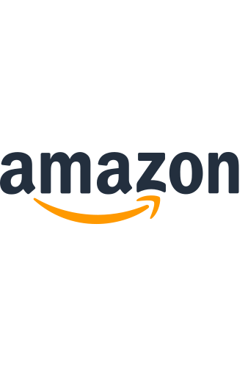

Barter
Cash
Credit
Online
Market
Cryptocurrency
I. Without Intermediary
Seller
Almaz’s
credit card details
Check
credit card detail and return affirmation.
Buyer
Transaction is successful If everything is fine.
Transaction fails If something is wrong.

Slide 15
Barter
Cash
Credit
Online
Market
Cryptocurrency
I. Without Intermediary
Pros:
Simple and Convenient.
Cons:
Requires private information to be handed to the seller.
Relies on credit.
Relies on central financial system (bank).

Slide 16


Barter
Cash
Credit
Online
Market
Cryptocurrency
II. With Intermediary
Intermediary
Almaz’s
credit card details
Approve and notify Seller
Buyer
Seller
Check & return affirmation.

Slide 17
Barter
Cash
Credit
Online
Market
Cryptocurrency
II. With Intermediary
Pros:
Seller is deprived of buyer’s private information.
Cons:
Lacks the simplicity of interacting with the seller.
Relies on credit.
Relies on central financial system (bank)

Slide 18
Barter
Cash
Credit
Online
Market
Cryptocurrency
To Summarize:
Barter is outdated with indefinite flaws for giant economy.
Cash and credit rely on a central system (bank) making it
Inconvenient and expensive to perform transactions.
Holds trust as collateral for its reliability.
Online market depends on cash and credit and lack substantial amount of privacy.
Solution???

Slide 19




Barter
Cash
Credit
Online
Market
Cryptocurrency
A system of validating transactions using a decentralized, trustless verification system.
Ledger
Helen pays Biruk 100Birr
Daniel pays Biruk 50Birr
Hana pays Helen 10Birr
.
.
.
Helen
Security Question 2:
How can you safeguard from a fraudulent signature?
Security Question 1:
What’s keeping anyone of the users from just adding a line? (Double spending)
Daniel
Helen
Biruk
Hana
Solution???
Digital Signatures
Solution???
Private Key (ATM Key)
Public Key (Bank account)
Daniel
Hana

Slide 20
Barter
Cash
Credit
Online
Market
Cryptocurrency
Ledger
Helen pays Biruk 100Birr
Daniel pays Biruk 50Birr
Hana pays Helen 10Birr
.
.
.
A system of validating transactions using a decentralized, trustless verification system.
Ledger
Helen pays Biruk 100Birr
Daniel pays Biruk 50Birr
Hana pays Helen 10Birr
.
.
.
Ledger
Helen pays Biruk 100Birr
Daniel pays Biruk 50Birr
Hana pays Helen 10Birr
.
.
.
Security Question 3:
What website or central website is hosting the ledger?
Helen
Biruk
Ledger
Helen pays Biruk 100Birr
Daniel pays Biruk 50Birr
Hana pays Helen 10Birr
.
.
.
Solution??? Decentralization
Ledger
Helen pays Biruk 100Birr
Daniel pays Biruk 50Birr
Hana pays Helen 10Birr
.
.
.
Daniel
Hana

Slide 21
Barter
Cash
Credit
Online
Market
Cryptocurrency
Ledger
Helen pays Biruk 100Birr
Daniel pays Biruk 50Birr
Hana pays Helen 10Birr
.
.
.
Ledger
Helen pays Biruk 100Birr
Daniel pays Biruk 50Birr
Hana pays Helen 10Birr
.
.
.
Add a transaction on a ledger then broadcast
Helen pays Daniel 10Birr
Helen
Biruk
Helen pays Daniel 10Birr
Ledger
Helen pays Biruk 100Birr
Daniel pays Biruk 50Birr
Hana pays Helen 10Birr
.
.
.
Ledger
Helen pays Biruk 100Birr
Daniel pays Biruk 50Birr
Hana pays Helen 10Birr
.
.
.
Daniel
Hana
Helen pays Daniel 10Birr
Helen pays Daniel 10Birr

Slide 22
Barter
Cash
Credit
Online
Market
Cryptocurrency
Ledger
Helen pays Biruk 100Birr
Daniel pays Biruk 50Birr
Hana pays Helen 10Birr
.
.
.
Ledger
Helen pays Biruk 100Birr
Daniel pays Biruk 50Birr
Hana pays Helen 10Birr
.
.
.
Add a transaction on a ledger then broadcast
Helen pays Daniel 10Birr
Helen
Biruk
Helen pays Daniel 10Birr
Ledger
Helen pays Biruk 100Birr
Daniel pays Biruk 50Birr
Hana pays Helen 10Birr
.
.
.
Ledger
Helen pays Biruk 100Birr
Daniel pays Biruk 50Birr
Hana pays Helen 10Birr
.
.
.
Daniel
Hana
Helen pays Daniel 10Birr
Helen pays Daniel 10Birr

Slide 23

Barter
Cash
Credit
Online
Market
Cryptocurrency
Ledger
.
.
.
Ledger
Helen pays Biruk 100Birr
Daniel pays Biruk 50Birr
Hana pays Helen 10Birr
.
.
.
Helen pays Biruk 100Birr
Add a transaction on a ledger then broadcast
Daniel pays Biruk 50Birr
Hana pays Helen 10Birr
Private Key:01001010
Public Key:01010101
But this process of clients constantly listening to transactions from other clients is not practical.
Private Key:111011000
Public Key:001010011
Helen pays Daniel 10Birr
Helen
Biruk
Helen pays Daniel 10Birr
Ledger
Helen pays Biruk 100Birr
Daniel pays Biruk 50Birr
Hana pays Helen 10Birr
.
.
.
Ledger
Helen pays Biruk 100Birr
Daniel pays Biruk 50Birr
Hana pays Helen 10Birr
.
.
.
Solution???
Blockchain
Daniel
Hana
Helen pays Daniel 10Birr
Helen pays Daniel 10Birr
Private Key:101000100
Public Key:101011010

Slide 24
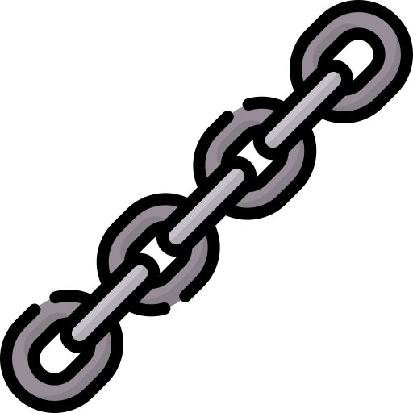
Barter
Cash
Credit
Online
Market
Cryptocurrency
Blockchain is a technology that allows data to be stored and transferred in a secure, decentralized, and transparent way.
Private Key:01001010
Public Key:01010101
Private Key:101000100
Public Key:101011010
Private Key:111011000
Public Key:001010011
Helen pays Biruk 100Birr
Daniel pays Biruk 50Birr
Hana pays Helen 10Birr
Time Stamp
Pointer to the previous block.

Slide 25

Barter
Cash
Credit
Online
Market
Cryptocurrency
How can you give this currency a value?
Value = Something rare
For example, cash used to be backed by either diamond, gold or silver.
1110101011010000101010000010101000101111010101011001011101001010000001010100010010101010101001011101
Crypto gives it’s currency a value by enticing it with a computational puzzle which is very difficult to solve.
Bitcoin combines the idea of using computational puzzles to regulate the creation of new currency units with the idea of secure timestamping to record a ledger of transactions and prevent double spending.
Private Key:01001010
Public Key:01010101
Private Key:101000100
Public Key:101011010
Private Key:111011000
Public Key:001010011
Helen pays Biruk 100Birr
Daniel pays Biruk 50Birr
Hana pays Helen 10Birr

Slide 26
Barter
Cash
Credit
Online
Market
Cryptocurrency
Miners: validate and add blocks in a blockchain by solving complex computational problems and are awarded crypto (bitcoin) for doing so.
1110101011010000101010000010101000101111010101011001011101001010000001010100010010101010101001011101
The process of solving mathematical problems to validate blocks is called Proof of work.
The process of validating and adding blocks to the blockchain is called Mining.
Private Key:01001010
Public Key:01010101
Private Key:10100010
Public Key:10101101
Private Key:11101100
Public Key:00101001
Helen pays Biruk 100Birr
Daniel pays Biruk 50Birr
Hana pays Helen 10Birr

Slide 27
Thanks for Listening.
This is all for lecture one, if you have questions please do ask

